Slide 1
C#

Slide 2


Strings
Strings are used for storing text.
A string variable contains a collection of characters surrounded by double quotes.

Slide 3

String Length
A string in C# is actually an object, which contain properties and methods that can perform certain operations on strings. For example, the length of a string can be found with the Length property.

Slide 4

String Methods
There are many string methods available, for example ToUpper() and ToLower(), which returns a copy of the string converted to uppercase or lowercase:

Slide 5


String Concatenation
The + operator can be used between strings to combine them. This is called concatenation:
You can also use the string.Concat() method to concatenate two strings:

Slide 6


Adding Numbers and Strings
If you add two numbers, the result will be a number:
If you add two strings, the result will be a string concatenation:

Slide 7

String Interpolation
Another option of string concatenation, is string interpolation, which substitutes values of variables into placeholders in a string.
Note that you do not have to worry about spaces, like with concatenation:

Slide 8


Access Strings
You can access the characters in a string by referring to its index number inside square brackets [].
This example prints the first character in myString:
You can also find the index position of a specific character in a string, by using the IndexOf() method:

Slide 9
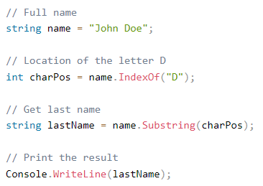
Access Strings
Another useful method is Substring(), which extracts the characters from a string, starting from the specified character position/index, and returns a new string.
This method is often used together with IndexOf() to get the specific character position:

Slide 10

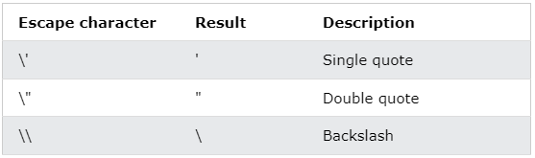
Special Characters
Because strings must be written within quotes, C# will misunderstand this string, and generate an error:
The solution to avoid this problem, is to use the backslash escape character.
The backslash (\) escape character turns special characters into string characters:

Slide 11
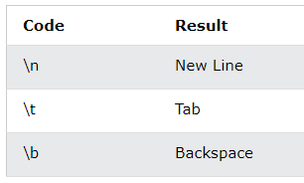
Special Characters
Other useful escape characters:

Slide 12
Booleans
Very often, in programming, you will need a data type that can only have one of two values, like:
YES / NO
ON / OFF
TRUE / FALSE
For this, C# has a bool data type, which can take the values true or false.

Slide 13
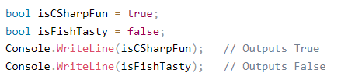
Boolean Values
A boolean type is declared with the bool keyword and can only take the values true or false:
However, it is more common to return boolean values from boolean expressions, for conditional testing.

Slide 14

Boolean Expression
A Boolean expression returns a boolean value: True or False, by comparing values/variables.
This is useful to build logic and find answers.
For example, you can use a comparison operator, such as the greater than (>) operator to find out if an expression (or a variable) is true:

Slide 15

Real Life Example
Let's think of a "real life example" where we need to find out if a person is old enough to vote.
In the example below, we use the >= comparison operator to find out if the age (25) is greater than OR equal to the voting age limit, which is set to 18:

Slide 16
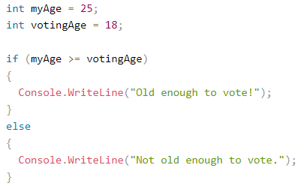
Real Life Example

Slide 17
Conditions and If Statements
C# supports the usual logical conditions from mathematics:
Less than: a < b
Less than or equal to: a <= b
Greater than: a > b
Greater than or equal to: a >= b
Equal to a == b
Not Equal to: a != b

Slide 18
Conditions and If Statements
You can use these conditions to perform different actions for different decisions.
C# has the following conditional statements:
Use if to specify a block of code to be executed, if a specified condition is true
Use else to specify a block of code to be executed, if the same condition is false
Use else if to specify a new condition to test, if the first condition is false
Use switch to specify many alternative blocks of code to be executed

Slide 19


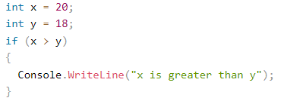
The if Statement
Use the if statement to specify a block of C# code to be executed if a condition is True.
In the example below, we test two values to find out if 20 is greater than 18. If the condition is True, print some text:

Slide 20
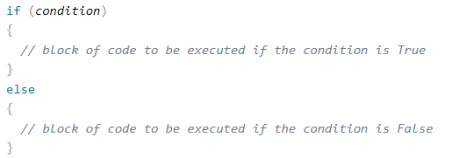
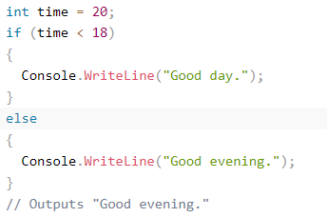
The else Statement
Use the else statement to specify a block of code to be executed if the condition is False.

Slide 21
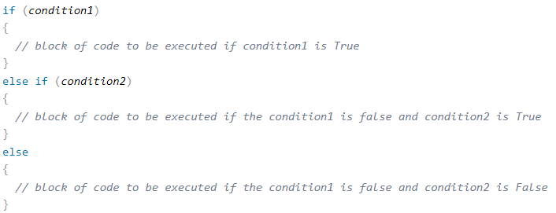
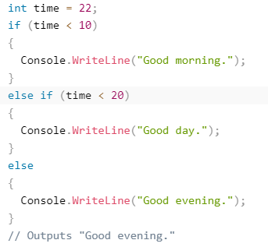
The else if Statement
Use the else if statement to specify a new condition if the first condition is False.

Slide 22
Short Hand If...Else (Ternary Operator)
There is also a short-hand if else, which is known as the ternary operator because it consists of three operands.
It can be used to replace multiple lines of code with a single line.
It is often used to replace simple if else statements:

Slide 23
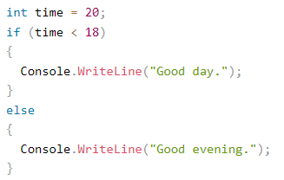

Short Hand If...Else (Ternary Operator)

